Slide 1
Password Security
Latanya N. Jenkins
LFI 4

Slide 2
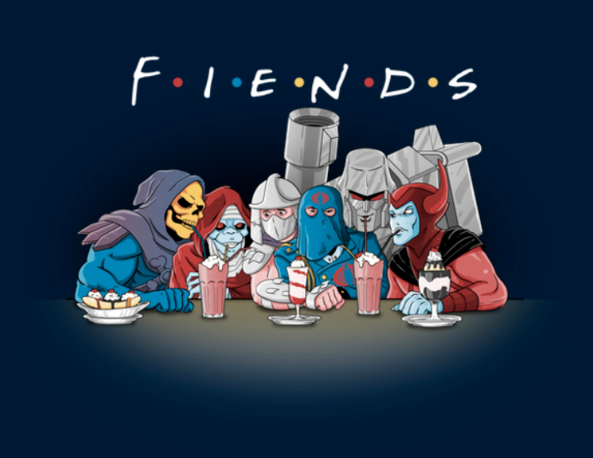
Share your Shakes NOT your Passwords.

Slide 3
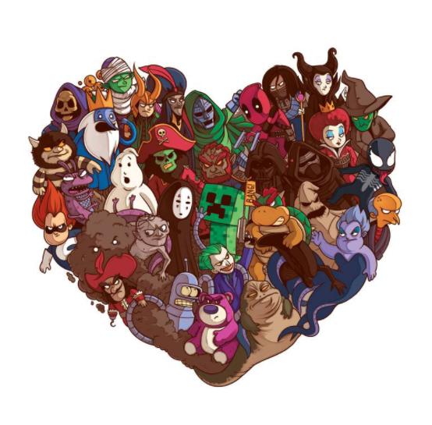
Give them Love, but NOT your Passwords…
Villains Need Love
by Naolito

Slide 4
Protect your Privacy!
If you’re completing, surveys on Face Book,
(ie. Which villain are you? Which princess are you?)
REVERSE ENGINEERING
If you’re sharing your location or Live Streaming on Instagram,
PRIVACY INVASION
If you’re tagging friends & family on Social Media…

Slide 5
Passwords
2 Factor Authentication
Use multiple different Passwords for Email versus Banking
Use the Tor browser
Use VPN
Use the DICE method in choosing your Password

Slide 6

Remember the ALL villains may not be intentional
Friends tagging you may open you up to Security Risks
Family using Surveys or Getting you to talk about a moment shared with you may be a Security Risk
YOU MAY BE PUTTING YOUR SECURITY AT RISK!
Your PARTNER
Your Parents/ Children

Slide 7
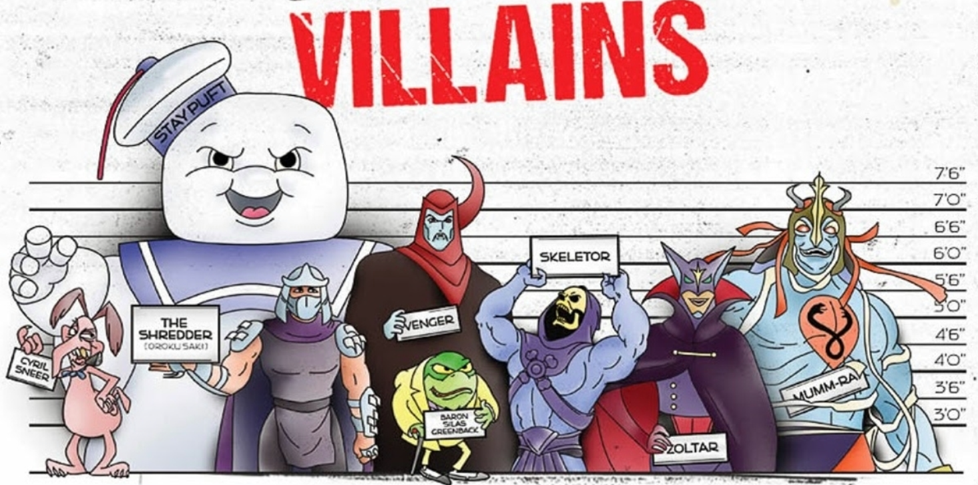

Slide 8
Realistic Solutions…
While there’s no perfect solution, except going totally offline.
Do not share your Passwords
Try to Read your Privacy Policies

